Slide 1
WGO Guidance for Patients with COVID-19 and liver disease
Contributors* in alphabetical order
MR Alvares da Silva, K Burak, T Chen, J Drenth, G Esmat,
R Gaspar, D Labrecque, A Lee, G Macedo, B McMahon,
Q Ning, N Reau, M Sonderup, DJ van Leeuwen
Edited by S Hamid and C Yurdaydin
* Members of Hepatology interest group, WGO
May 15,2020

Slide 2
Topics COVID-19 and Liver Disease
COVID-19 overview, nomenclature
General approach if liver test abnormalities
Liver co-morbidities
Chronic Viral hepatitis B and C
Metabolic dysfunction associated fatty liver disease (MAFLD)
Autoimmune hepatitis
Practical aspects clinical care
Follow-up if chronic liver disease
Performing Procedures
Investigational therapies, potential hepatotoxicity
Management of complications
Screen and treatment for HCC
Patients awaiting and after liver transplant

Slide 3
COVID-19:Overview and nomenclature
B Mc Mahon (USA)
April 22, 2020

Slide 4
Viral Characteristics SARS-Cov-2 - 1
Coronaviruses: positive-sense 30,000 bp, single stranded RNA viruses
7 strains
in wild animals and humans: to date some strains only in wild animals
Can jump from animals to humans causing disease (e.g. MERS, SARS, COVID-19)
Alphacoronaviruses can cause mild illnesses (common cold or influenza like symptoms)
SARS-CoV-2 is strain resulting in COVID-19 (betacoronavirus):
Betacoronaviruses can be divided into two groups
MERS similar structural viruses
SARS and SARS-CoV-2
COVID-19 is the name for the illness caused by SARS-CoV-2.
Elifiky AA. Life Sciences 2020. in Press

Slide 5
Viral Characteristics of SARS-CoV-2 -2
RNA dependent RNA polymerase (RdRp) site highly conserved.
RdRp of SARS-CoV-2 closest strain to SARS RdRp with 90% sequence identity values vs. 57% to MERS.
SARS-CoV-2 first identified in Wuhan, China, now pandemic.
At the latest count, it has caused more than 5 million infections and over 300,000 deaths globally. (May 26, 2020)
Mortality due to the coronaviruses:
SARS 10%
MERS 30%
SARS-CoV-2- unknown but could range from << 1-2% to as high as 4-5%
- 20% or more in elderly persons with co-morbid conditions

Slide 6
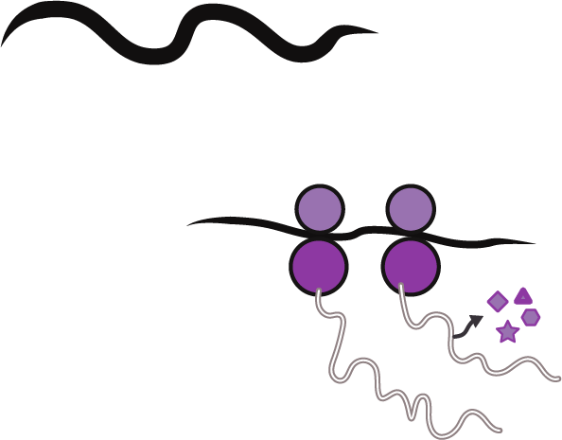
CoV Replication and Life Cycle
Entry and Uncoating
Virus enter the cells through acid-dependent membrane fusion
Spike
.
Attachment
Virus Spike protein attaches to ACE2 on cell surface as an entry receptor
Production of Virus Particles
ACE2, the cell’s receptor
Translation
(+)
New Virion Assembly
Viral translation with host ribosomes into polyproteins
Release of Virus
Mature virions form at host ER/Golgi compartment
Ribosomes
Proteolysis
RdRp
PLpro and 3CLpro cleave polyproteins into ~20 non-structural and structural proteins
Proteases
PLpro & 3CLpro
Type II Pneumocyte
Golgi
RNA Replication
(+)
Viral genome replication by RdRp
RdRp
Nucleus
(+)
(+)
New viral genome
(+)

Slide 7
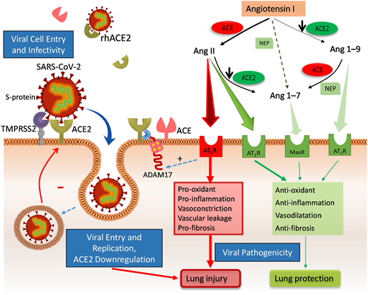
Role of ACE-2 in COVID-19
Viral entry into cell
Downregulation in lungs by virus leads to:
Reduced Ang 1-7 > Reduced lung protection
Increased Ang-II > Increased lung injury

Slide 8
General Approach to the Patient with COVID-19 and elevated liver enzymes
D.J. van Leeuwen (USA/Rwanda)
Q Ning (China)
A Lee (Australia)
April 22, 2020

Slide 9
Liver test abnormalities in COVID-I9
Incidence range from 14-76% from mild, transient increase to (very rare) severe hepatitis
ALT and AST increase most commonly reported
Bilirubin increased in about 10% cases.
GGT increased in about 50% cases.
Guan WJ, N Engl J Med 2020; Fan Z, Clin Gastroenterol Hepatol 2020;
Cai Q, J Hepatol 2020.

Slide 10
Published early studies
Bangash MN et al, Lancet, 2020
 | Group | Patients (N) | Alanine aminotransferase (IU/L) | Aspartate aminotransferase (IU/L) | Prothrombin time (s) | Bilirubin (μmol/L) | Elevated lactate dehydrogenase, creatinine kinase, or myoglobin | Mortality (%)
Guan et al (2020) | ICU or death | 67 | Not known | Not known | Not known | Not known | Yes | 22% (day 51)
Huang et al (2020) | ICU | 13 | 49 (29–115) | 44 (32–70) | 12·2 (11·2–13·4) | 14·0 (11·9–32·9) | Yes | 38% (day 37)
Chen et al (2020) | Hospitalised | 99 | 39 (22–53) | 34 (26–48) | 11·3 (1·9) | 15·1 (7·3) | Yes | 11% (day 24)
Wang et al (2020) | ICU | 36 | 35 (19–57) | 52 (30–70) | 13·2 (12·3–14·5) | 11·5 (9·6–18·6) | Yes | 17% (day 34)
Shi et al (2020) | Hospitalised | 81 | 46 (30) | 41 (18) | 10·7 (0·9) | 11·9 (3·6) | Unclear | 5% (day 50)
Xu et al (2020) | Hospitalised | 62 | 22 (14–34) | 26 (20–32) | Not known | Not known | Unclear | 0% (day 34)
Yang et al (2020) | ICU | 52 | Not known | Not known | 12·9 (2·9)* | 19·5 (11·6)* | Not described | 62% (day 28)
Extracted from all studies above | Chronic liver disease | 42 | Not known | Not known | Not known | Not known | Not known | 0–2% †
Notes:
This table from the review by Bangash et al(2020) in multiple groups of severely ill patients (selection bias) illustrates that abnormal liver tests are common, severe disease as reflected in relatively mild elevation of bilirubin is uncommon and multiple etiologies / confounders of these manifestations may be present including the consequences of myositis, and drug-induced (experimental ) therapy etc.

Slide 11
Liver test abnormalities and severity of COVID- I9
May be more common in patients with severe systemic disease.
Increases in ALT and AST usually not > 3 x ULN.
Increase in AST (>40 IU/L) associated with higher mortality (52%) compared to those who recover (16%).
Low serum albumin levels (<32 g/L) associated with high mortality*.
In critically ill patients (ICU), multi-causality common
Significantly abnormal tests:
Transaminases > 3-5x ULN, bilirubin > 3 ULN: Other causes become more likely
*Chen T, BMJ 2020
Notes:
+ The virus is different from viral hepatitis type A-E that primarily affect the liver
+ There is no suggestion that the virus profoundly directly ‘resonates’ in the liver like for example Ebstein-Barr or CMV may do
+ No suggestion as yet that it could act like hepatitis A infection in patient with underlying liver disease (N)ASH and fulminant outcome (reason why we recommend vaccination)
review by Bangash et al, Lancet 2020
+ No reports as yet that remotely suggest any fulminant hepatic failure type of disease as component of severe disease. Reviewed by +
+Lippi, G Eur J Gastroenterol Hepatol. 2020 Apr 10 Chronic liver disease is not associated with severity or mortality in Coronavirus disease 2019 (COVID-19): a pooled analysis

Slide 12
Liver test abnormalities in COVID- I9
(mostly addressed in following contributions)
Risk if NASH/Obese? See section on MASH
Increased risk if alfa-1-antitrypsin deficiency with pulmonary disease? (no reports yet)
Safety of augmentation therpay likely okay, subgroups with liver /lung transplant
Myositis : (AST > ALT, CPK) (Mao et al, 2019)
ICU patients: Abnormal liver enzymes often multi-causal
Experimental therapy may lead to drug toxicity
Immune modulators: for better for worse? (Suzman et al, 2018)
Notes:
Mao L, Jin H, Wang M, Hu Y, Chen S, He Q, et al. Neurologic manifestations of hospitalized patients with coronavirus disease 2019 in Wuhan, China. JAMA Neurol. doi: 10.1001/jamaneurol. 2020.1127. [Published online 2020 Apr 10].
Genovese, M.C., Arthritis & Rheumatology, 2017;
Chen, L.F., . Int J Rheum Diseases, 2017
Suzman DL et al Liver International 2018: 38: 967-87

Slide 13
Pathogenesis of liver abnormalities in COVID-19
ACE 2 receptors on cholangiocytes, to lesser extent on hepatocytes.
Direct injury plausible, no data to support this until recently (see below).
Limited biopsies with non specific findings of steatosis and acute hepatitis, hepatocyte apoptosis with lobular lymphohistocytic inflammation without viral inclusions*.
However, recently ultrastructural and histological changes indicative of viral hepatitis including typical coronavirus particles characterized by spike structure in cytoplasm of hepatocytes in 2 patients**
Consider drug induced liver injury, hypoxic hepatitis and role of overactive immune mediated pro-inflammatory response.
Incidental finding of preexisting liver/biliary tract disease?
*Xu Z, Lancet Respir Med. 2020, **Wang Y et al, J Hepatol 2020

Slide 14
Interpretation of tests
Hypoalbuminemia Typical in patients with severe inflammatory response (no independent indicator of liver failure)
Prolonged INR /thrombocytopenia Spontaneous coagulopathy DIC in 1/3 of sick patients may explain prolonged PT / INR (1) Thromboembolic events likely common in COVID19
High transaminases/ Bilirubin (> 3 x ULN) Rarely reported: consider other causes
Anemia GI bleeding likely? Ulcer, Variceal hemorrhage?
Imaging If no or inadequate imaging done , US may be indicated: CBD obstruction, suspected advanced disease Tumor/thrombosis
Klok FJ, 2020, Hemostasis Research

